Slide 1

PROJECT SYNOPSIS
AI-BASED DISASTER EARLY WARNING AND RESPONSE SYSTEM
SUBMITTED BY
INSTITUTION
Suraj Singh (230970170043)
THDC Institute of Hydropower Engineering & Technology
Varun Mundepi (230970170046)
Tehri Garhwal, Uttarakhand
Ayush Petwal (230970170013)
October 2026
B.Tech CSE (AI & ML)
THDC-IHET | Department of Computer Science & Engineering
1

Slide 2

Project Declaration
We hereby declare that the synopsis entitled “AI-Based Disaster Early Warning and Response System” is our original work and has not been submitted to any other University or Institution for the award of any degree or diploma.
Suraj Singh
Varun Mundepi
Ayush Petwal
230970170043
230970170046
230970170013
THDC-IHET | Department of Computer Science & Engineering
2

Slide 3

Table of Contents
01
Introduction & Motivation
05
Proposed Methodology
02
Problem Statement & Objectives
06
Technologies Used
03
Literature Survey
07
Evaluation & Timeline
04
Research Gap
08
Future Scope & Conclusion
THDC-IHET | Department of Computer Science & Engineering
3

Slide 4

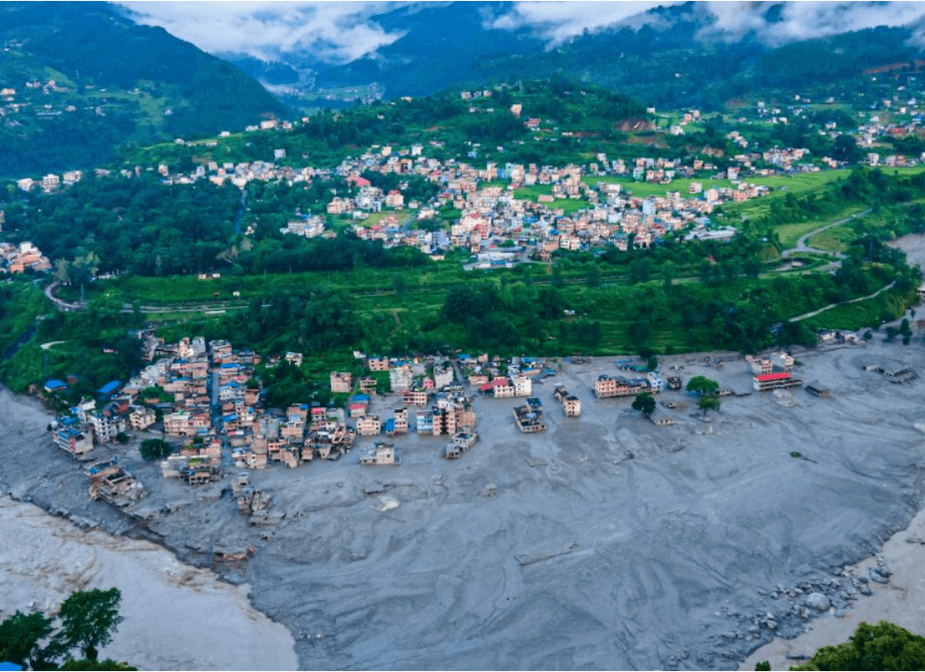
Introduction & Motivation
India, especially the Himalayan state of Uttarakhand, is frequently hit by devastating floods, flash floods, and landslides.
Current disaster information is fragmented across multiple agencies (IMD, NASA, GSI) and formats, creating significant delays for local decision-makers.
Project Motivation: Use AI to unify environmental data into a single, map-based interface for regional disaster preparedness and response.
Vulnerable regions in the Himalayan state of Uttarakhand.
THDC-IHET | Department of Computer Science & Engineering
4

Slide 5

Problem Statement & Objectives
CORE OBJECTIVES
CRITICAL SCOPE & LIMITATIONS
✓
Collect and prepare weather, terrain, and historical hazard data.
Prototype status: Not a replacement for official warning services.
✓
Develop flood and landslide risk models using Random Forest.
Data Dependency: Performance relies on the quality of available labels.
Target: Preliminary preparedness, not tactical emergency response.
✓
Build a React dashboard with an interactive Leaflet risk map.
✓
Develop FastAPI endpoints for prediction and alert history.
THDC-IHET | Department of Computer Science & Engineering
5

Slide 6

Literature Survey & Research Gap
Category
Sources / Methods
Key Findings
IMD, NASA (GPM/SRTM), GSI
Satellite precipitation and elevation data provide critical features for mountainous terrain.
Environmental Data
Random Forest, Logistic Regression
Random Forest effectively handles non-linear relationships in slope and rainfall data.
Risk Assessment
Leaflet, OpenStreetMap
Real-time map-based dashboards significantly improve situational awareness.
Visualisation
The Identified Gap
While many systems exist for individual hazards, there is a need for a unified decision-support prototype that integrates multi-hazard risk assessment, map-based visualization, and a formal alert history specifically for the Himalayan context.
THDC-IHET | Department of Computer Science & Engineering
6

Slide 7

Proposed Methodology
01
02
03
04
Data Intake
ML Inference
API Layer
Dashboard
IMD, NASA, GSI APIs & historical hazard records
Random Forest prediction models (Proposed)
FastAPI endpoints & PostgreSQL storage
React frontend with Leaflet interactive map
System Layer
Primary Responsibility
Data & Processing
Cleaning, feature engineering, and inference pipelines.
Backend & DB
API routes, alert rules, and persistent prediction logs.
Frontend
Real-time visualization, charts, and alert management.
THDC-IHET | Department of Computer Science & Engineering
7

Slide 8

Technologies Used
FRONTEND
BACKEND
DATA & ML
INFRASTRUCTURE
React.js
FastAPI
scikit-learn
PostgreSQL
Component-based UI with Leaflet for maps and Axios for API calls.
Python
Pandas
Git
Asynchronous endpoints, Pydantic validation, and alert logic.
Data cleaning, Random Forest models, and model evaluation.
Persistent data storage, SQLAlchemy ORM, and version control.
THDC-IHET | Department of Computer Science & Engineering
8

Slide 9

Evaluation & Timeline
PERFORMANCE METRICS
14-WEEK TIMELINE
Target
Metric (Proposed)
W1–W3
Data Research
Risk Models
Precision, Recall, F1-Score
W4–W7
Model Training
System API
Response Time, Uptime
W8–W9
Backend Dev
Alert Pipeline
Delivery Success Rate
W10–W11
Frontend Dev
W12–W14
Testing & Demo
* Leakage-aware test splitting will be used for model validation.
THDC-IHET | Department of Computer Science & Engineering
9

Slide 10

Major Contributions & Future Scope
INTENDED CONTRIBUTIONS
FUTURE EXTENSIONS
→
A unified full-stack prototype (React + FastAPI) for Himalayan hazards.
→
Integration of real-time sensor networks for higher local precision.
→
Hazard-specific ML pipelines for flood and landslide risk.
→
Expansion to other hazards (e.g., forest fires, seismic activity).
→
Map-based visualization of risk categories and data timestamps.
→
Mobile-native alerts using push notifications and SMS gateways.
THDC-IHET | Department of Computer Science & Engineering
10

Slide 11

Conclusion
Proposed as a web-based decision-support prototype for flood and landslide risk in Uttarakhand.
Integrates data processing, machine learning, and map-based visualization.
Focuses on preliminary preparedness and communication of uncertainty.
"This prototype is intended for academic learning and preparedness support; it does not replace or override official disaster warning services."
THDC-IHET | Department of Computer Science & Engineering
11

Slide 12

References
[ "
counter(ref)
" ]
India Meteorological Department
[ "
counter(ref)
" ]
PostgreSQL & PostGIS Documentation
https://mausam.imd.gov.in/
https://www.postgresql.org | https://postgis.net
[ "
counter(ref)
" ]
Scikit-learn Documentation
[ "
counter(ref)
" ]
React.js Documentation
https://scikit-learn.org/stable/
https://react.dev/
[ "
counter(ref)
" ]
Pandas & NumPy Documentation
[ "
counter(ref)
" ]
Leaflet & OpenStreetMap
https://pandas.pydata.org | https://numpy.org
https://leafletjs.com | https://openstreetmap.org
[ "
counter(ref)
" ]
FastAPI Documentation
https://fastapi.tiangolo.com/
THDC-IHET | Department of Computer Science & Engineering
12

